Slide 1


Fundamentals
Where do I find MATLAB? Here!
Do I have to have MATLAB installed on my computer right now? No, you can use MATLAB Online!

Slide 2

Table of Contents
What we've covered this week in Part 2 Data Types Extra Learning What we've covered this week in Part 3
MATLAB Live Script

Slide 3
What we've covered this week in Part 2
This week in Part 2 we learnt about:
How to access MATLAB
The MATLAB desktop
MATLAB Cheat Sheet
Obtaining help in MATLAB
Basic debugging in MATLAB

Slide 4
Data Types
There are many different data types, or classes, that you can work with in MATLAB. You can build matrices and arrays of the following data types:
floating-point
integer data
characters and strings,
logical true and false values, and so on
The following data types provide a way to store dissimilar types of data in the same container:
tables
timetables
structures
cell arrays
There are 16 fundamental classes in MATLAB, each of these classes is in the form of a matrix or array (more on matrices and arrays in week 2: “Arrays, Matrices and Operators). This matrix or array is a minimum of 0-by-0 in size and can grow to an n-dimensional array of any size.

Slide 5
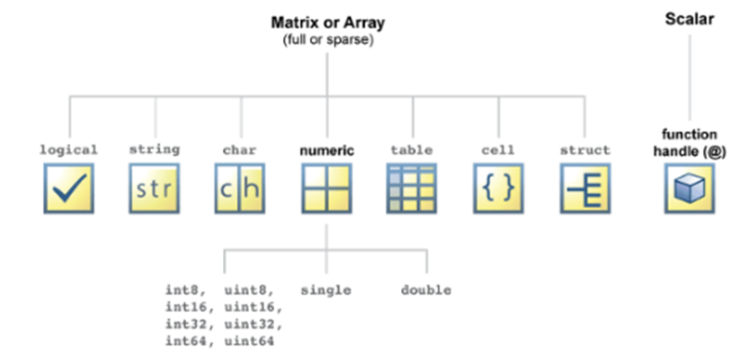
Data Types
All the fundamental MATLAB classes are shown in the diagram below:
See this table that describes the fundamental classes in more detail.
Let’s see some examples using some of these fundamental data types.

Slide 6

Data Types
Let’s create a string and character array.
Run the code (using the Run Section button ), and check the class of str and chr in the Workspace:
str = "This is a string array" %Enclose text in double quotes to create a string
chr = 'This is a character array' %Enclose text in single quotes to create a character array
MATLAB displays strings with double quotes and character vectors with single quotes. The difference between these two data types, is that str will be stored as a 1-by-1 string or a string scalar whereas chr will be stored as a 1-by-12 character vector (confirm this in the Workspace browser).

Slide 7

Data Types
Now you try! Create a string of your name and a character array of your surname:
%Write your code here
%String of your name
%Character array of your surname

Slide 8
Extra Learning
We can store our two variables (more on variables in Variables and Commands section in Part 4 of Week 1), str and chr, and an additional numeric variable in one container data type :
number = 25;
%Cell array data type
cellArray = {str, chr, number} %Cell array made up of a string, character array and a double
%Structure data type
structure.stringField = str; %Structure with a field assigned a value of class string
structure.characterArrayField = chr; %Structure with a field assigned a value of class char
structure.numericDoubleField = number; %Structure with a field assigned a value of class double
structure %Structure with three fields assigned values of different classes.
%Table data type
table(str, {chr}, number, 'VariableNames', {'String', 'Character', 'Double'}) %Table with variables of different classes

Slide 9
Extra Learning
Now you try! Create a table with your name, surname, and your age:
%Write your code here
%Double value of your age
%Table with three variables/columns: Name, Surname and Age
We can create a logical data type variable in a few ways, one of them is to use MATLAB built-in functions, in our case we’ll use the isa function to check a variable’s data type:
tf = isa(str, 'char') %We’re checking if str is a character, this should return a false
Now you try! Create a logical variable:
%Write your code here
%Check the data types of one of your variables

Slide 10
What we've covered this week in Part 3
This week in Part 2 we learnt about:
Data types

Slide 11
MATLAB Live Script
Click on the link below for this lecture’s MATLAB live Script
Week_1_Part_3_Fundamentals.mlx
Copyright 2022 The MathWorks, Inc. & Opti-Num Solutions (Pty) Ltd.

